Slide 1
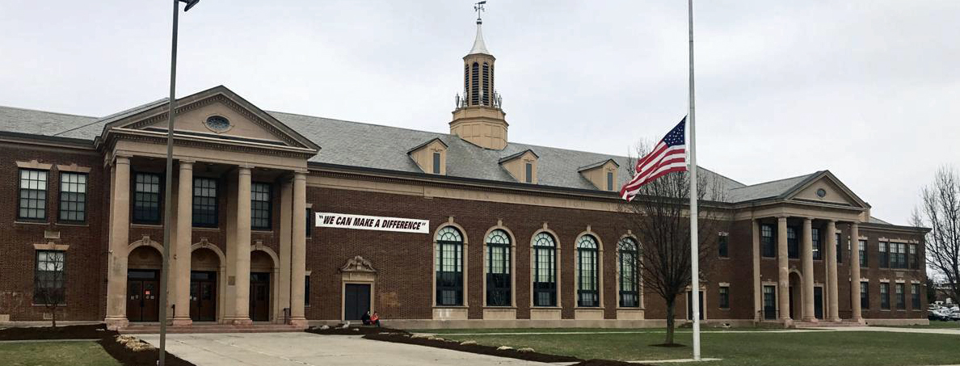

7th Grade Orientation
7th Grade Orientation
2025-2026
2025-2026

Slide 2
Name Tags

Slide 3
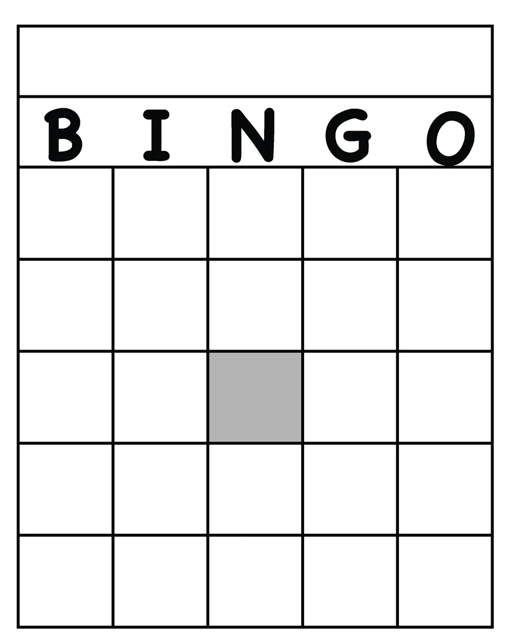
Icebreaker Bingo
Directions: Time to get to know some new friends! For this activity you will be wandering the room and finding a friend in the room who matches the pieces on the bingo board.
Example: Find a friend in the room who is an only child and cross that box out. The goal is to cross out a row of five.

Slide 4
School Expectations
*General behavior & respect for all-teachers, classmates, facilities (Golden Rule)
*Procedures-arrival/entry, go to locker and then directly to homeroom, be on time to class
*Attendance/Tardiness (you need to be here!)
*Cell Phone Policy (Updated)

Slide 5
Bell Schedule
Fill in the blanks from your own schedule

Slide 6
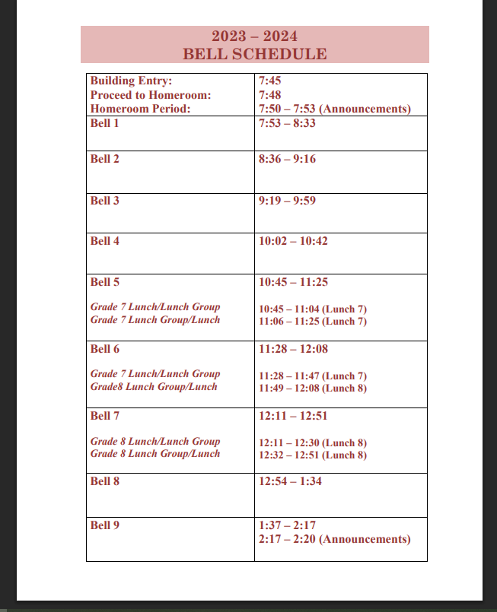

Slide 7
Locker Combination
*Top Right of your Schedule*

Slide 8


Slide 9
Time to Practice Lockers & Schedules

Slide 10
Scavenger Hunt

Slide 11


