Slide 1
8th Grade Parent/Student Information Night

Slide 2
Agenda Welcome & Introductions Individual Scheduling Meetings Role of the School Counselor Review of Scheduling Process & Transition to High School Graduation Requirements Typical 9th Grade Schedule & Course Selection Academic Plan & High School Transcript NCAA Student Athletes College & Career Planning

Slide 3
Auburn High School Staff
Principal
Mr. Morgan
Assistant Principals
Mrs. LaManna(A-F)
Mrs. Wicks(G-N)
Mr.Testa (O-Z)
Counselors
Mr. Crosby (A-Cq)
Dr. Hoskins-Tardibone (Cr-Ha)
Mr. Walker (He-Me)
Mrs. Stryker (Mi-Sc)
Ms. Shurant (Se-Z)

Slide 4
Individual Scheduling Meetings
The Junior High school counselors will meet with 8th grade students individually to finalize course selections and academic plans.
Parents- Please sign up tonight, call, or email the junior high counselors if you would like to participate.
Mr. Salvage- Last Names A-Le Mrs. Walsh- Last Names Li- Z
(ph) 315-255-8490 (ph) 315-255-8532
geraldsalvage@aecsd.education margaretwalsh@aecsd.education

Slide 5
Your School Counselor Can Help With…
Academics
Assist with course selection that will allow you to graduate and reach your post secondary goals.
Help determine interventions to improve academic success.
Career
Career exploration
Choosing your path (college, work force, military)
Personal & Social Concerns
Positive decision-making
Developing healthy relationships
Coping with personal issues

Slide 6
8th to 9th Grade Scheduling Process
Week of 8th Grade Classroom Presentations
Jan 23rd Course Guides Distributed
Jan 25th 8th Grade Parent/Student
Information Night
Feb- April Annual scheduling review meetings
Final course selections will be mailed
August New Student Orientation at AHS

Slide 7
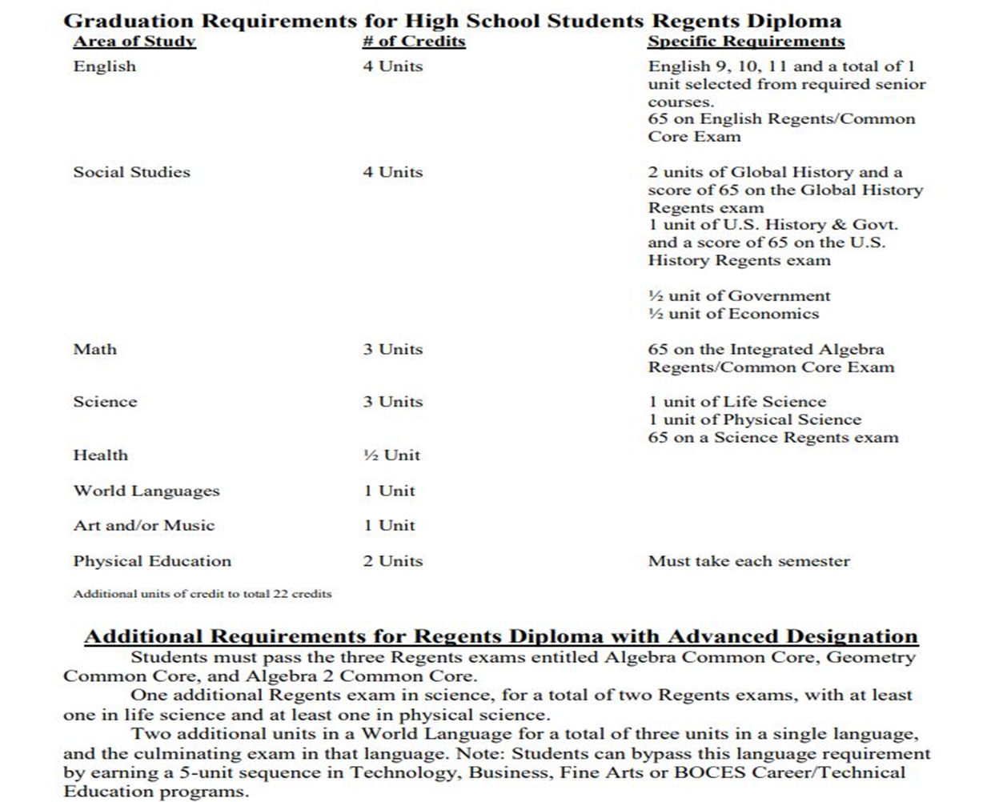

Slide 8
Typical 9th Grade Schedule
English 9R
Global History 9R
Math
Science
World Language
PE
Electives or Study Halls
Lunch

Slide 9
Academic Intervention Services (AIS)
AIS is provided to students to help them successfully meet their graduation requirements.
Placement is determined by NYS Math and ELA 8th grade assessments and/or prior academic performance.

Slide 10
Academic Plans
Academic Plans start in junior high school.
Academic Plans are updated and adjusted each year based on students’ needs, interests, and graduation requirements.

Slide 11
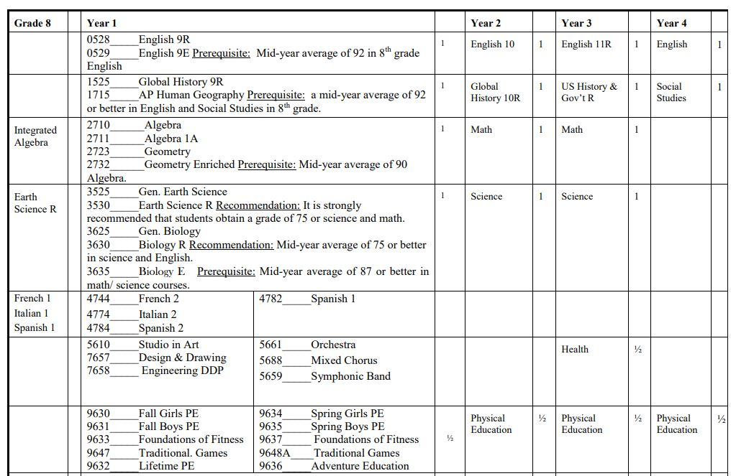

Slide 12
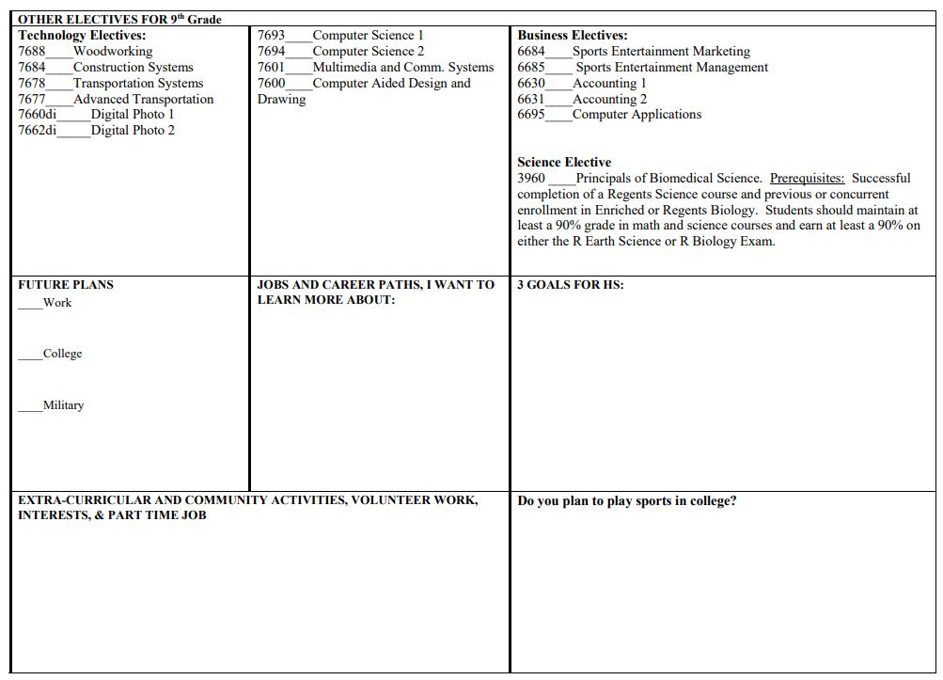

Slide 13
The Importance of Your High School Transcript
Your transcript is a complete record of all courses and final course grades for every class you take in high school.
It includes your class rank and grade point average as well as your highest Regents exam scores.

Slide 14
The Importance of Your High School Transcript
This document is required for all college and scholarship applications, as well as for the military and some employers.
It is very important that students do their best in every course taken in grades 9 through 12. 8th grade courses such as World Language, Algebra, and Earth Science are also included on the transcript.

Slide 15
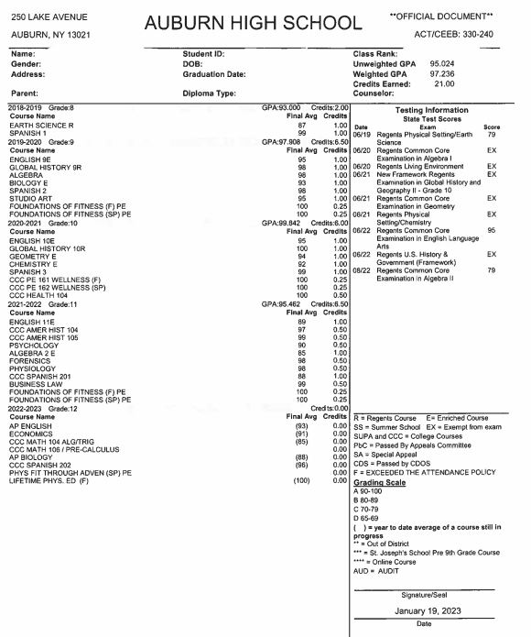
Sample
High School
Transcript

Slide 16
Family Educational Rights and Privacy Act of 1974 (FERPA)
Students who are applying to colleges, please be aware that procedures for the confidentiality of student records within FERPA have changed.
FERPA permits school officials to disclose, upon request, any and all educational records, including disciplinary records, to any institution to which the student applies for enrollment.

Slide 17
Student Athletes NCAA Clearinghouse Requirements
Students who wish to participate in intercollegiate athletics at the NCAA Division I or Division II levels must be certified by the NCAA Clearinghouse.
Please note that Division III Colleges, as well as junior colleges, do not require NCAA eligibility certification.
It is critical that student athletes and their families share their athletic goals with the school counselor beginning in 8th grade to ensure that the students are registered for the necessary NCAA-approved courses in high school.

Slide 18
College and Career High School Planning Activities
Individual College & Career Counseling
College Night and workshops
Rotary Club Career Presentations
BOCES Road Show/New Visions
PSAT Testing for 10th and 11th graders

Slide 19
College and Career High School Planning Activities
College representative visits
Alumni Panels- Career & College
Counseling Department newsletters
Cooperative Education Program

Slide 20
SCOIR
Scoir supports post-secondary, college and career planning. It is designed to assist students and their parents/guardians in making informed decisions about college opportunities and career choices.
Scoir is also being connected to PrinciplesYou, where students can complete interest and personality assessments and complete career search and exploration.

Slide 21
Experience College at AHS Advanced Placement Courses
Biology Computer Science US History
Calculus English Literature US Government
Chemistry Human Geography World History

Slide 22
Experience College at AHS Project Lead the Way Engineering
Technology Project Lead the Way through
Rochester Institute of Technology
Introduction to Engineering/DDP
Principles of Engineering
Digital Electronics
Civil Engineering & Architecture

Slide 23
Experience College at AHS Project Lead the Way Biomedical
Biomedical Project Lead the Way through
Various Colleges
Principles of Biomedical Science
Human Body Systems
Medical Interventions
Biomedical Innovations

Slide 24
Experience College at AHS Cayuga Community College

Slide 25
Experience College at AHS Cayuga Community College
Essentials of Art Painting Studio 1 Cayuga 101
Business Math 105 Consumer Math 106 Prin. of Accounting
English 101 English 102 Prin. of Business
College Algebra/Trig Precalculus Calculus
American History 104 American History 105 Music Theory
Wellness Center I Wellness Center II Health
Biology 103 Biology 104 Physics 101
French 103 French 104
Italian 103 Italian 104
Spanish 201 Spanish 202

Slide 26
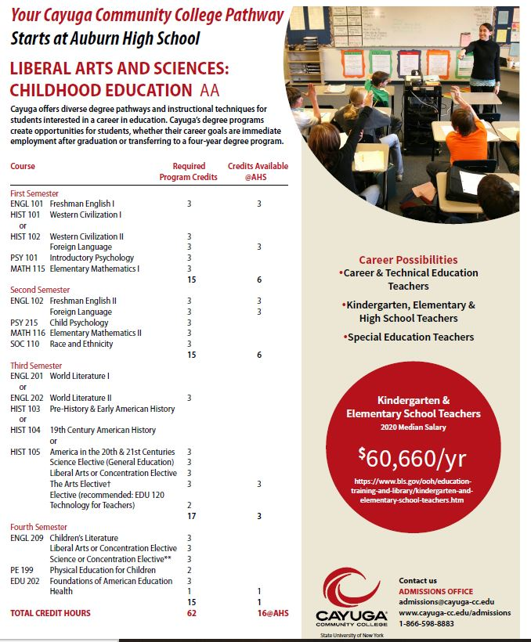
Liberal
Arts & Science
Childhood
Education
16 out of 62 credits
can be completed
at AHS

Slide 27
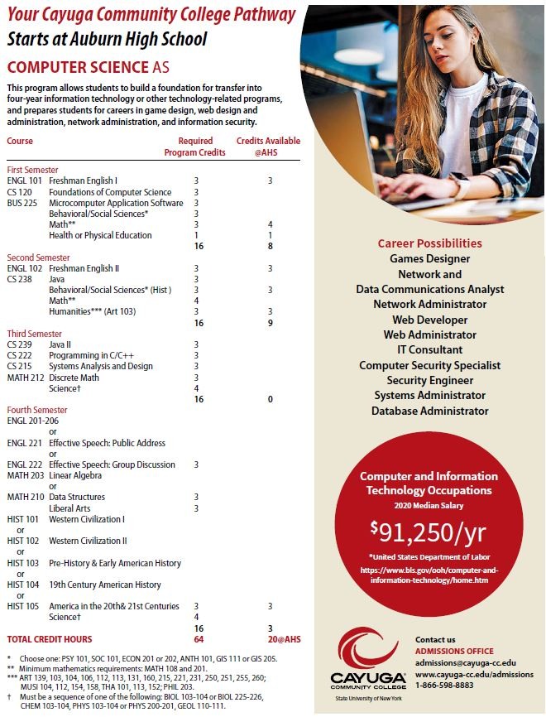
Computer Science
AS Degree
20 out of 64 credits
can be completed
at AHS

Slide 28
Things to Remember
If your child is receiving special education services, please attend his/her Annual Review meeting this spring.
You will be notified of the meeting date and time.
If you would like to attend your child’s scheduling meeting AJHS, please sign up tonight, email or call your child’s school counselor.
If you are from a parochial school, contact the appropriate high school counselor.

Slide 29
THANKS!
Looking forward to welcoming the Class of 2027!

